Slide 1
Plant Doctor A Neural Network tool for detecting leaf diseases

Slide 2
Presented by
Iftekhar Jamil (BSSE0802)
Ibrahim Khalil (BSSE0804)
Tulshi Chandra Das (BSSE0811)

Slide 3
How it works
Take An Image of Leaf
Upload
Get Prediction

Slide 4
Methodology
Collect Dataset
Generate an NN Model
Predict for a sample

Slide 5
Dataset
Dataset is collected from here:
https://github.com/spMohanty/PlantVillage-Dataset/tree/master/raw/color
Contains 23 different classes
7 different crops type
We will work on Tomato leaf diseases
Tomato leaf has 8 different classes ( 7 unhealthy, 1 healthy)

Slide 6
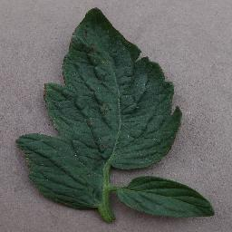
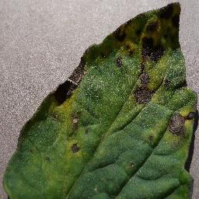
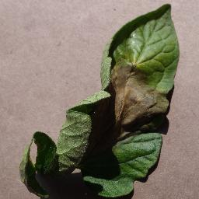
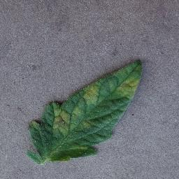
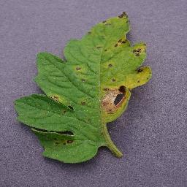
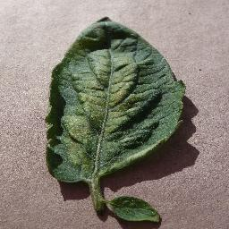
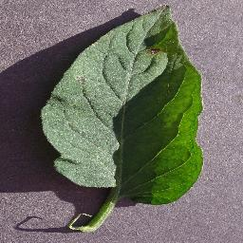
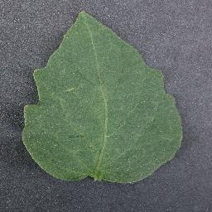
Dataset
Bacterial spot
Early blight
Late blight
Leaf mold
Septoria spot
Spider spot
Target spot
Healthy leaf

Slide 7
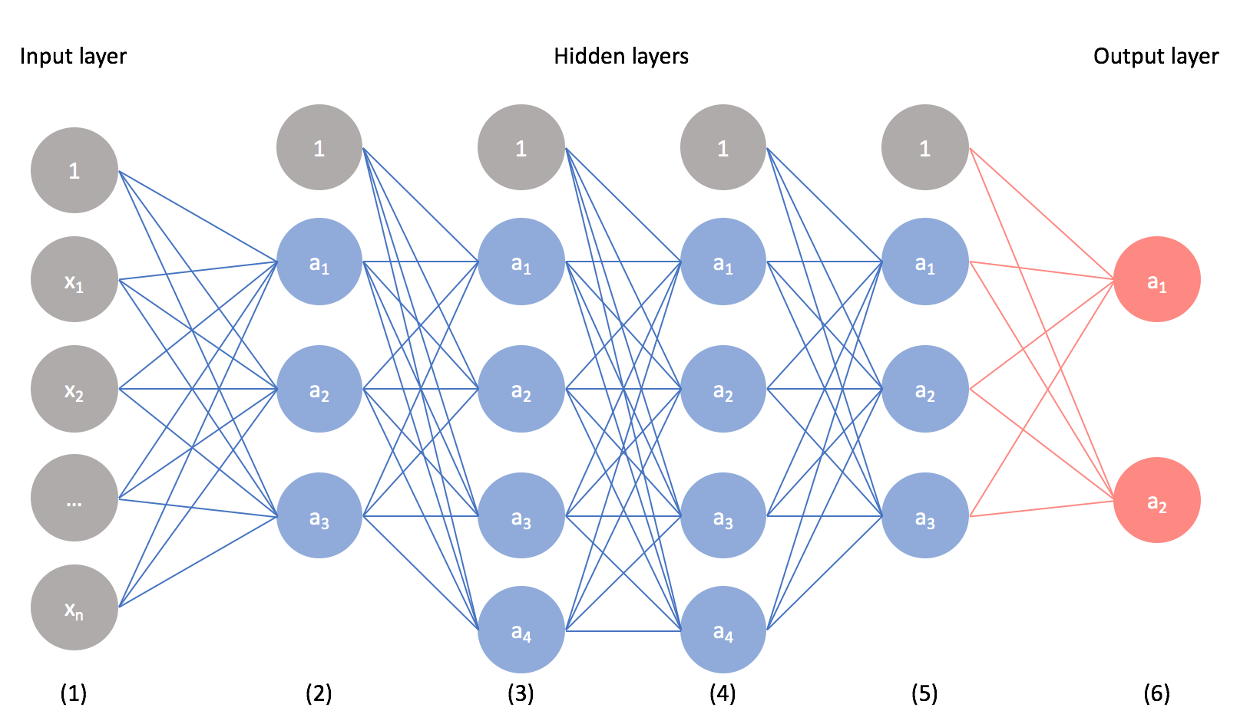
Generate an NN Model
CNN is a category of NN that is used to do image recognition, image classification, object detection and so on.

Slide 8
Tools and Technologies
Python
Keras
Numpy
OpenCV
Matplotlib

Slide 9
Thank You

